Slide 1
Global Energy and Sustainable Development Strategy in the XXI century

Slide 2
Plan
INTRODUCTION
Alternative energy sources
Basics of Kazakhstan’s ecological energy strategy
ECOLOGICAL ENERGY FUTURE: A STRATEGY FOR THE XXITH CENTURY
G-global project and energy-saving strategies
Water-is a strategic resource in the XXI century
Water managment

Slide 3
INTRODUCTION
The world is currently undergoing a transformation the complexity of which has only become clear of late. The notion that the availability of non-renewable energy resources is limited and its end is on the horizon has become generally accepted. The awareness of the need to address environmental and climatic changes on the planet and their impact on living conditions has become widespread alongside.
.

Slide 4
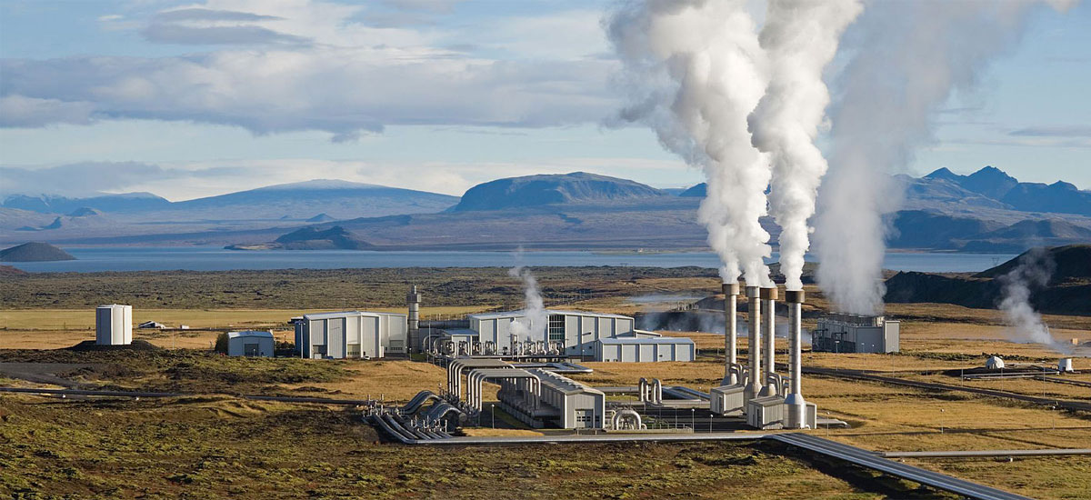
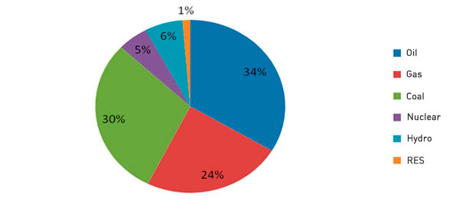
energy sources in the XXI century

Slide 5
Environmental impacts of power
Environmental impact of electricity generation:
The environmental impact of electricity generation is significant because modern society uses large amounts of electrical power. This power is normally generated at power plants that convert some other kind of energy into electrical power. Each system has advantages and disadvantages, but many of them pose environmental concerns.

Slide 6
Environmental impacts of power
Environmental impacts of power
The amount of water usage is often of great concern for electricity generating systems as populations increase and droughts become a concern.

Slide 7
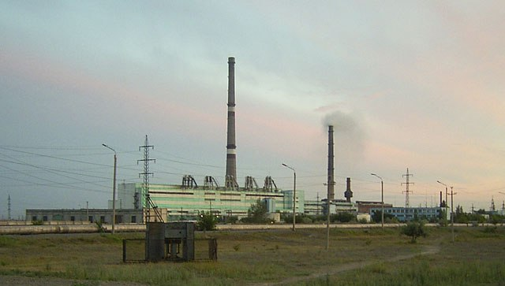
Most electricity today is generated by burning fossil fuels and producing steam which is then used to drive a steam turbine that, in turn, drives an electrical generator.

Slide 8
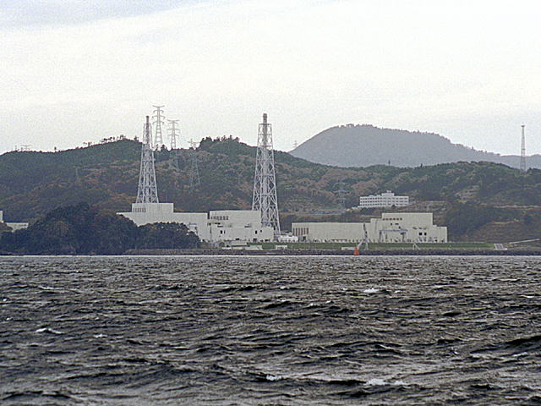
Nuclear power plants do not burn fossil fuels and so do not directly emit carbon dioxide; because of the high energy yield of nuclear fuels, the carbon dioxide emitted during mining, enrichment, fabrication and transport of fuel is small when compared with the carbon dioxide emitted by fossil fuels of similar energy yield.

Slide 9
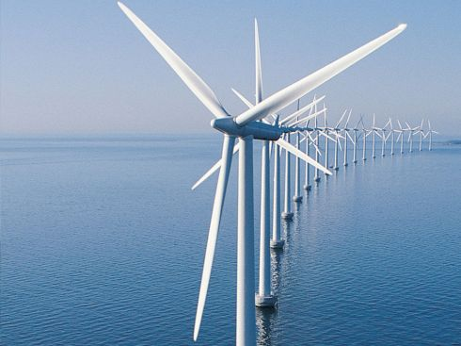
Environmental power - replacement of conventional energy

Slide 10

alternative energy sources
By 2050, one-third of the world's energy will need to come from solar, wind, and other renewable resources. Who says? British Petroleum and Royal Dutch Shell, two of the world's largest oil companies. Climate change, population growth, and fossil fuel depletion mean that renewables will need to play
a bigger role in the future than they do today.

Slide 11
Alternative energy is any energy source that is an alternative to fossil fuel.
These alternatives are intended to address concerns about such fossil fuels. Iit causes less pollution too.
The nature of what constitutes an alternative energy source has changed considerably over time, as have controversies regarding energy use.
An alternative source of energy is a renewable resource.

Slide 12
Renewable energy is the energy source which, according to human scale, are inexhaustible
The basic principle of the use of renewable energy is extracted from its permanent place in the environmental processes and the provision of technical use.
Renewable energy is derived from natural resources such as sunlight, water currents, wind, tides and geothermal heat, which are renewable.

Slide 13
Renewable Energy Sources
Wind energy
Water power
The energy of the tides
Wave energy
The energy of sunlight
Geothermal energy
Bioenergetics

Slide 14
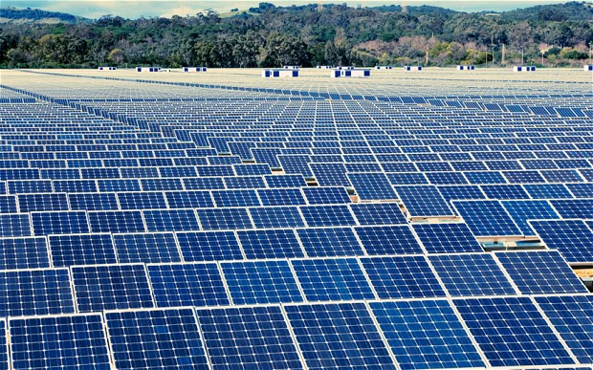
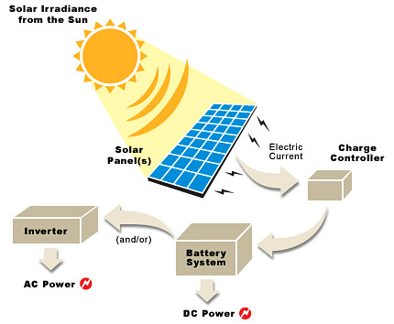
Solar
Power

Slide 15
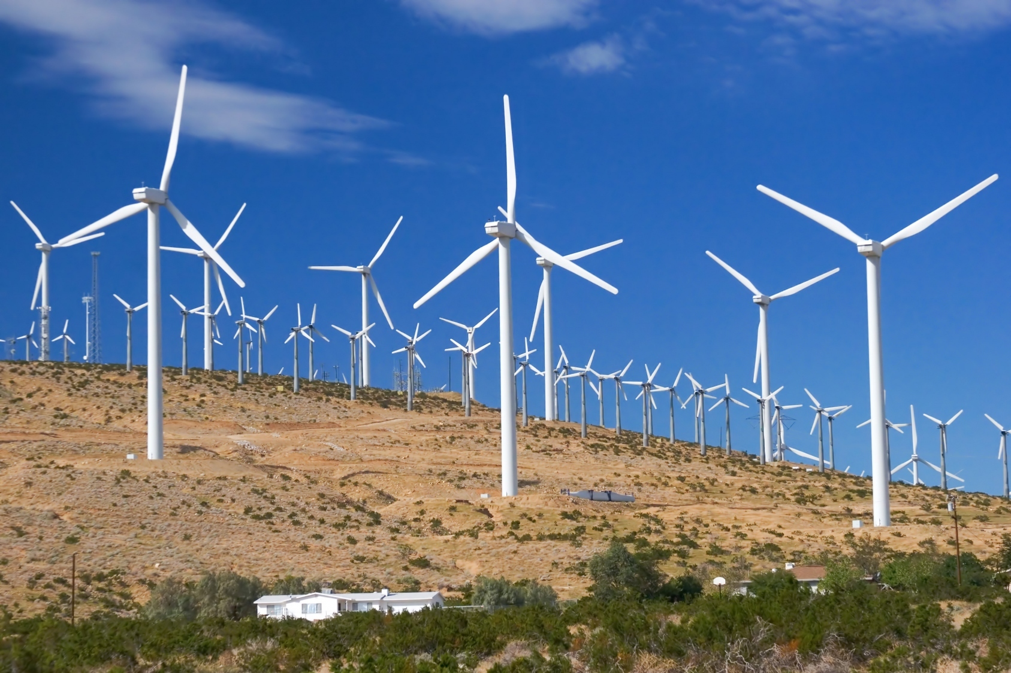
Wind Power

Slide 16
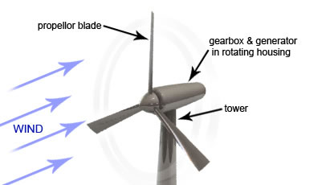
Wind power, as an alternative to burning fossil fuels, is plentiful, renewable, widely distributed, clean, produces no greenhouse gas emissions during operation, and uses little land. The net effects on the environment are far less problematic than those of nonrenewable power sources
ALTERNATIVE ENERGY SOURCES:WIND POWER

Slide 17
Basics of Kazakhstan’s ecological energy strategy
In the President’s address to the nation concerning the national strategy up to 2030, the principles of the policy to be pursued in regard to the use of the country’s energy resources were mentioned under Priority 5. “Kazakhstan possessed enormous reserves of natural resources, especially energy-producing ones. The oil and gas deposits under our country’s soil put us among the ranks of world top-10 reserve holders. Kazakhstan also possesses large reserves of coal, uranium, gold and other valuable commodities. We have a big potential for the use of wind and solar energy.

Slide 18
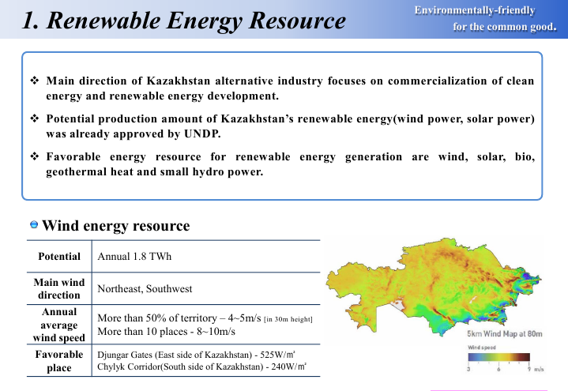

Slide 19
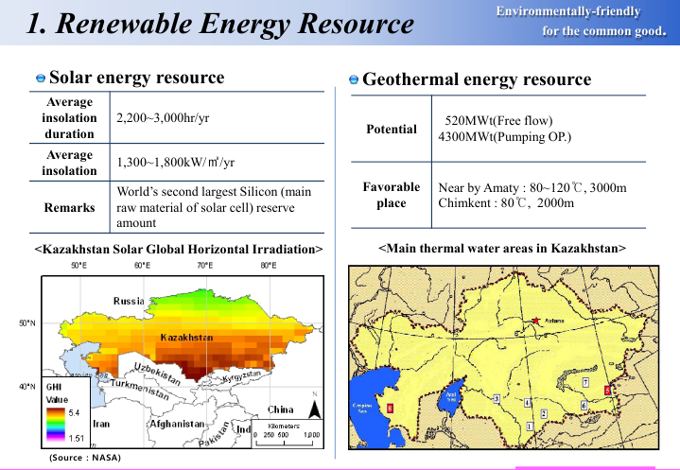

Slide 20
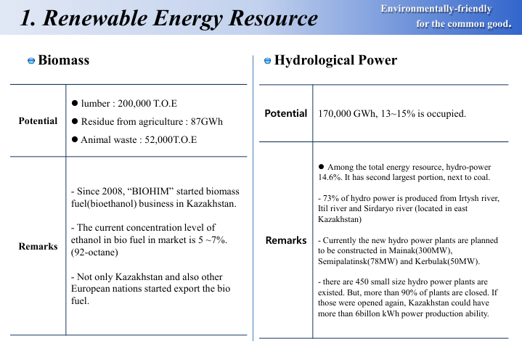

Slide 21

G-global project and energy-saving strategies

Slide 22
The Global Energy and Economical Strategy, which was initiated by N. Nazarbayev offered to the world innovative theoretical and practical approaches of solution of global and regional energy and ecological problems that were supported at the Rio+20, were adopted by the world community for implementation, and in this connection, they require further scientific development.

Slide 23

STATEMENTS OF THE PRESIDENT OF KAZAKHSTAN N.A.NAZARBAYEV
Last year I proposed to create a group of countries G-Global, as a complement to the mechanism of G-20, in order to create an international economic policy and seek global anti-crisis solutions. Today, G-Global is an international virtual platform at Astana Economic Forum, established by the Association "Eurasian Economic Club of Scientists".
FROM THE SPEECH OF THE PRESIDENT OF KAZAKHSTAN IN CAMBRIDGE UNIVERSITY ON 26.07.2012

Slide 24
G-global project and energy-saving strategies
Alternative energy sources
G-Global - a feature-rich platform to create the conditions for the international expert community for interactive, open and public debate, a debate on the global economy. The project aims to discuss and develop mechanisms to resolve the global financial crisis and aims to dramatically expand the number of participants in search of anti-crisis solutions
The success of the forthcoming international exhibition EXPO 2017 “Future Energy” depends largely on the active participation of citizens in the implementation of energy-environment concept of modernity, presented by the President Nursultan Nazarbayev as a formula for sustainable development of the civilization in XXI century.

Slide 25
GOALS AND OBJECTIVES:
Consolidate the efforts of the world community in understanding the global challenges of civilizations and the creation of effective solutions for the progressive development of the world economy
ADVANTAGES:
To integration with social networks, focusing on business professional communication
An unprecedented interaction with the site of the Astana Economic Forum and harmonious transition to the offline mode with the continuation of the debate during the forum
Unique Intelligent software platform: 21 Nobel laureates, members of the Astana club of Nobel laureates, have contributed to the development of G-Global

Slide 26
G-GLOBAL is five principles:
1 evolution and rejection of revolutionary change in policy
2 justice, equality, consensus
3 global tolerance and trust
4 global transparency
5 constructive multilateralism

Slide 27

Simple Strategies to Maximize Energy Savings
1) Use programmable thermostats (properly)
2) Implement lighting changes
3) Turn off computers and other equipment at the end of the day
4) Form an employee green team
5) Check interiors and exteriors for damage
6) Find underperforming equipment (and replace it)
7) Join or start a local green business council
« I'm not an environmentalist. I'm an Earth warrior.».
~Darryl Cherney, quoted in Smithsonian, April 1990

Slide 28

Efficient energy use, sometimes simply called energy efficiency, is the goal to reduce the amount of energy required to provide products and services.

Slide 29
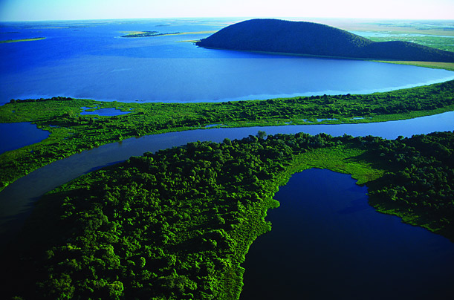

Slide 30

Water Resources

Slide 31
Water is a strategic resources in 21th
.
Water resources are sources of water that are useful or potentially useful. Uses of water include agricultural,industrial, household, recreational and environmental activities. The majority of human uses require fresh water.
97 percent of the water on the Earth is salt water and only three percent is fresh water; slightly over two thirds of this is frozen in glaciers and polar ice caps.

Slide 32
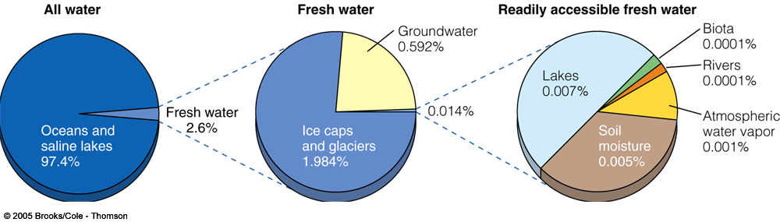
Supply of Water Resources
Small fraction (.014%) is readily
available for human use

Slide 33
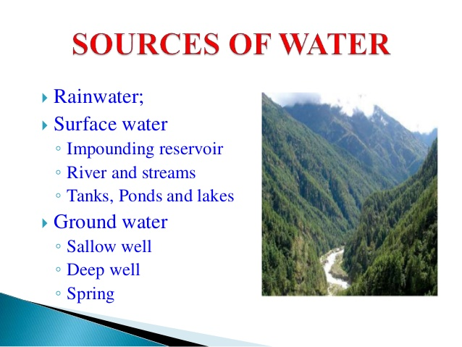

Slide 34
Use of Water Resources
Humans directly or indirectly use about 54% of reliable runoff
Withdraw 34% of reliable runoff for:
Agriculture – 70%
Leave 20% of runoff in streams for human use:
transport goods, dilute pollution, sustain fisheries
Industry – 20%Could use up to 70-90% of the reliable runoff by 2025

Slide 35
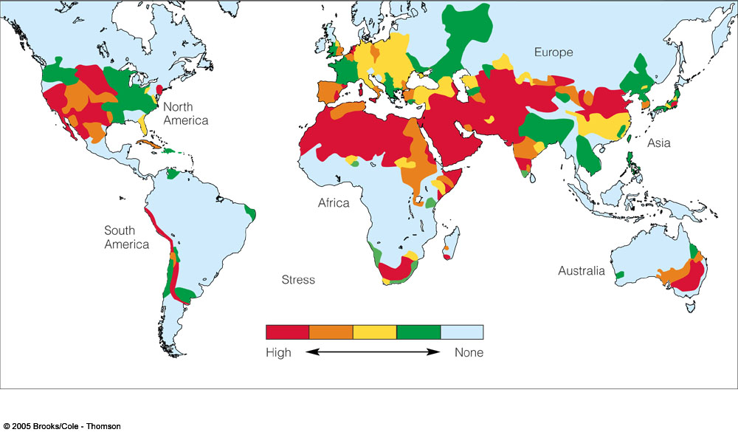
Water conflicts: Global
Two main factors for water shortage: dry climate and too many people. Many people live in hydro poverty – can’t afford clean water.

Slide 36
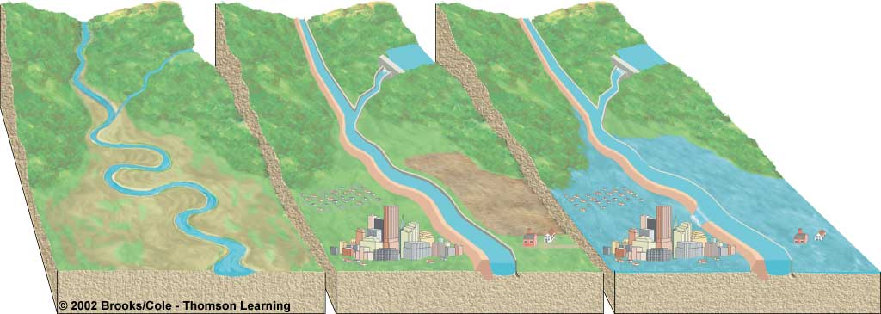
Too Much Water: Floods
Natural phenomena
Aggravated by human activities
Rain on snow Living on floodplains
Impervious surfaces
Removal of vegetation
Draining wetlands
Reservoir
Dam
Levee
Flood
wall
Floodplain

Slide 37
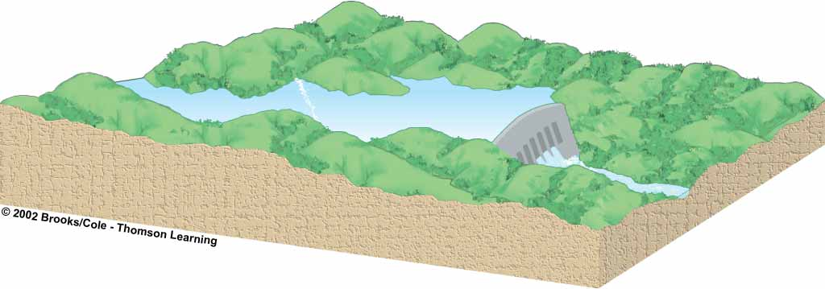
Using Dams and Reservoirs to Supply More Water: The Trade-offs
Flooded land destroys forests or cropland and
displaces people
Downstream cropland and
estuaries are deprived of
nutrient-rich silt
Large losses
of water through
evaporation
Downstream flooding is reduced
Reservoir is useful for recreation and fishing
Provides water
for year-round
irrigation of
cropland
Can produce cheap electricity (hydropower)
Migration and spawning of some fish are disrupted

Slide 38
Solutions Sustainable Water Use
Not depleting aquifers
Preserving ecological health of aquatic systems
Preserving water quality
Integrated watershed management
Agreements among regions and countries sharing surface water resources
Outside party mediation of water disputes between nations
Marketing of water rights
Raising water prices
Wasting less water
Decreasing government subsides for supplying water
Increasing government subsides for reducing water waste
Slowing population growth

Slide 39

It is estimated that 22% of worldwide water is used in industry. Major industrial users include hydroelectric dams, thermoelectric power plants, which use water for cooling, ore and oil refineries, which use water in chemical processes, and manufacturing plants, which use water as a solvent. Water withdrawal can be very high for certain industries, but consumption is generally much lower than that of agriculture.

Slide 40
Water resource management
Water resource management is the activity of planning, developing, distributing and managing the optimum use of water resources. It is a sub-set of water cycle management. Ideally, water resource management planning has regard to all the competing demands for water and seeks to allocate water on an equitable basis to satisfy all uses and demands. As with other resource management, this is rarely possible in practice

Slide 41
Water is an essential resource for all life on the planet. Of the water resources on Earth only three percent of it is fresh and two-thirds of the freshwater is locked up in ice caps and glaciers. Of the remaining one percent, a fifth is in remote, inaccessible areas and much seasonal rainfall in monsoonal deluges and floods cannot easily be used. At present only about 0.08 percent of all the world’s fresh water is exploited by mankind in ever increasing demand for sanitation, drinking, manufacturing, leisure and agriculture.

Slide 42
Water in the Future:
One of the biggest concerns for our water-based resources in the future is the sustainability of the current and even future water resource allocation. As water becomes more scarce the importance of how it is managed grows vastly. Finding a balance between what is needed by humans and what is needed in the environment is an important step in the sustainability of water resources.

Slide 43
CONCLUSIONS
Basic conditions for an ecological energy policy to be
successful in the course of the XXIst Century include:
– each and every country should have enough energy
resources at its disposition needed for its national
economic development;
– the balance between the shares of conventional and
renewable energy resources on national levels should
be kept intact;
– consumption patterns of energy should be kept under
control with the aim to use available provisions as
efficiently as possible;
– nations should assume joint responsibility regarding
climate changes;
–energy resources for future generations should be
secured;
–interstate cooperation in maintaining the balance
between ecological constraints and energy needs should be enhanced.

Slide 44
CONCLUSION
The present XXI century is an epoch of strengthening integration of civilizations, their dialogue and partnership for solution of emerging global problems faced by the mankind. It may be stated definitely that the modern world of the beginning of XXI century is a world of local civilizations demonstrating their spatial variety of historical heritage and modern being of the mankind. In the period not later than the middle of the century the gap in economical parameters between counties should be reduced to the extent allowing all states having an opportunity for securing a high level of human potential development. This is a very difficult task; it is connected with considerable growth of the world gross product and solution of major tasks both on the global level and, what is particularly difficult, in each country.

Slide 45
References
http://epswa.com.au/
http://climatepolicyinitiative.org/
http://e-lib.kazntu.kz/
http://www.noblepower.com/
https://en.wikipedia.org/wiki/Environmental_impact_of_electricity_generation
"Executive Summary: Assessment of Parabolic Trough and Power Tower Solar Technology Cost and Performance Forecasts“
http://www.rechargenews.com/wind/europe_africa/article1328060.ece
http://strategy2050.kz/
http://www.ramboll.com/megatrend/feature-articles/Water-one-of-the-biggest-challenges
https://en.wikipedia.org/wiki/Water_resources

Slide 46
REFERENCE
1 “Perspectives on sustainable energy for the 21th century” (SD21)
2 Energy for a sustainable future. Available at http://
www.un.org/millenniumgoals/pdf/AGECCsummaryreport[1].pdf
Allen, M. (2009).
3 Antonia V. Herzog et. al. (2001). Renewable energy: a viable energy choice. http://rael.berkeley.edu/sites/default/files/old-site-files/2001/Herzog-
Lipman-Edwards-Kammen-RenewableEnergy-2001.pdf
4 Banuri, T., & Opschoor, H. (2007). Climate Change and Sustainable Development (Research report submitted to the United Nations/Division of Economic
and Social Analysis, New York). New York: United Nations, DESA.
5 Bazilian, M., Hobbs, B., Blyth, W., MacGill, I., & Howells, M. (2011). Interactions between energy security and climate change: A focus on developing
countries, Energy Policy, Elsevier, vol. 39(6), pages 3750-3756, June.
6 Internet website www. en.wikipedia.org

